Slide 1

Technology in Sports: Instant Replay
Andrew Wu

Slide 2

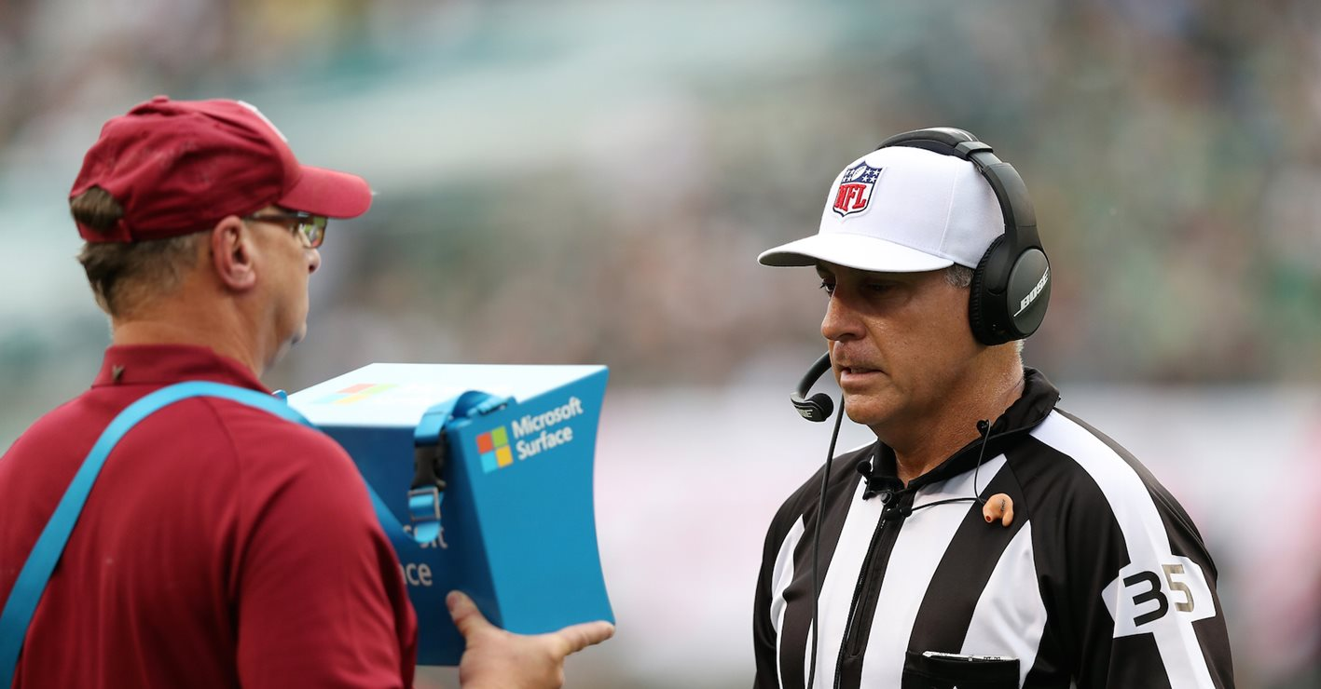
What is instant replay?
Instant replay is a reproduction of previous footage of play that’s shown again to game officials for review.

Slide 3
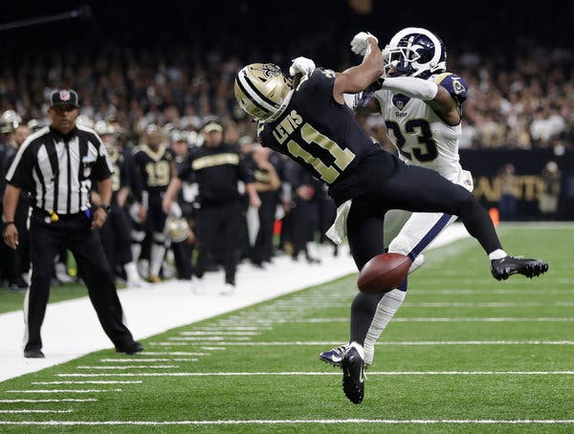
What is instant replay? (Cont’d)
Used when coaches want to challenge calls on the field.

Slide 4
The beginning (1976-1984)
Instant Replay first started out in 1976 when Arc McNally, the then director of officiating, wanted to figure out how long a video review would delay a game.
Using a stopwatch and video camera, he observed a Monday Night Football game between the Dallas Cowboys and the Buffalo Bills.
He saw a missed call during the game that could’ve been corrected.
The system was lackluster, being that the technology was costly to implement, more cameras were needed than available, and calls remained inconclusive after extensive review.
Unwilling to implement this costly measure, the NFL shelved instant replay until the mid-1980s.
Two years later, the first test of instant replay came during the 1978 Hall of Fame game between the Philadelphia Eagles and Miami Dolphins.

Slide 5
Initial Instant replay (1985-1992)
Using 8 preseason games in 1985, the NFL tested a review system…with promising results.
A subsequent vote on a playoff implementation narrowly failed, but it was clear to the league that it was a change that it was being considered.
In the 1985 system, a replay official monitored the game from a booth and initiated reviews, reversing only when the call was “indisputable.”
The initial process lacked the challenges and technology known today.
Officials sat in a booth with two nine-inch tv’s showing the broadcast feed and two videocassette recorders (which could record and replay individual plays).
Reviews were two minutes long.
After the first year, some adjustments were made to improve the system.
Training clinics were held to make refs familiar with technology.
Review monitors were upgraded from 9 to 12 inches.

Slide 6
Bumps and Miscues
Due to communication miscues over the given walkie-talkies, the league replaced them with pagers and radio sets.
Terminology was changed to clear terms such as “confirmed” and “reversed” to avoid confusion.
Despite these changes, instant replay was killed again in 1991 when 17 owners voted against renewal, believing that the system delayed games too much and failed to get enough of the calls correct.

Slide 7
Picked up again
In 1996, a new system was approved for testing in 10 preseason games.
  Coaches could challenge.
    3 plays per half.
  Replay now covered:
    Out of bounds.
    Number of players on field.
    Scoring plays.
  No more skyboxes. Referees can review on field inside booth equipped with monitors.
    Only 90 seconds for review.

Slide 8
However…
Coaches hated it and voted against implementation for the 1997 regular season.
They considered the review costing a timeout portion (even with a successful challenge) to be a main hang-up, so the league adjusted the rules again.
This time, some main criticisms were addressed.
2 challenges per half.
Timeouts charged only on unsuccessful challenges.
Replay assistant initiated reviews inside final two minutes.
After two years of testing, all on-field officials were equipped with headsets for wireless communication, allowing them to communicate and discuss calls more quickly.

Slide 9
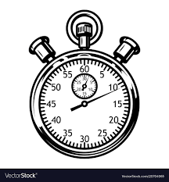
The current system
The referees have 60 seconds to make a call.

Slide 10
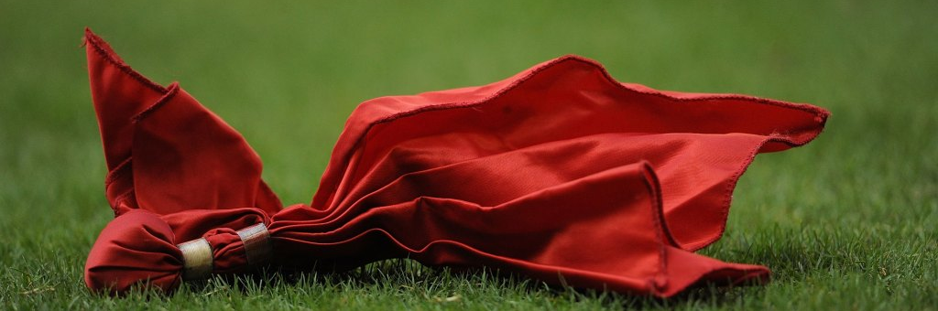
The current system (Cont’d)
2 challenge flags for each coach. Thrown to challenge official ruling on the field.

Slide 11
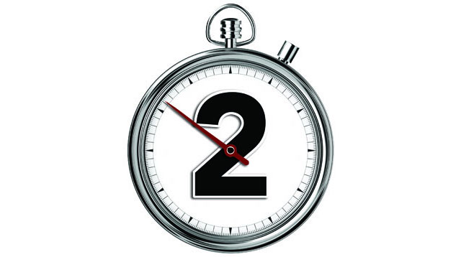
The current system (Cont’d)
Once the two-minute warning hits, coaches cannot challenge inside the play. Only the replay assistant can determine whether a play should be reviewed within that time.

Slide 12
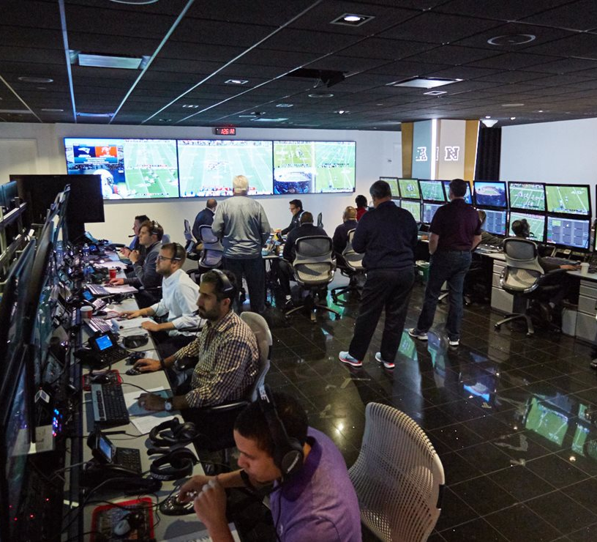
Art McNally Gameday Central

Slide 13
Behind the scenes
https://www.youtube.com/watch?v=EYR1uHoRfe4

Slide 14
The controversies
The camera angles the referees see are the same ones we see at home.
Pass interference calls/lack of pass interference calls is/was a point of emphasis.
Certain rules were controversial (ex: Tuck Rule).
Rule interpretation by the referees.

Slide 15
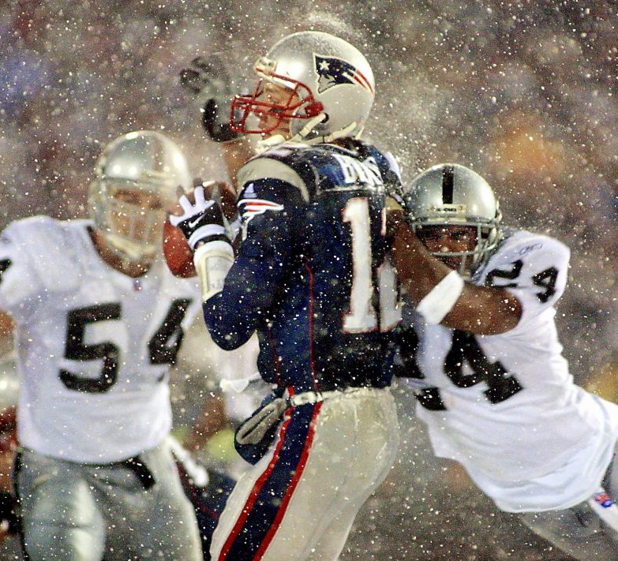
The tuck rule

Slide 16
Fail Mary
https://www.youtube.com/watch?v=wXGFZkIEMK0

Slide 17
Q&A Time

Slide 18
Bibliography
Given, K. (2017, February 3). The 'Tuck Rule' Game That Started A Dynasty ... And A Backlash. Retrieved from https://www.wbur.org/onlyagame/2017/02/03/patriots-tuck-rule.
History of Instant Replay. (n.d.). Retrieved from https://operations.nfl.com/the-game/history-of-instant-replay/.
Martinez, R. (2008, November 9). Baltimore Ravens vs. Houston Texans. Retrieved from https://media.gettyimages.com/photos/red-challenge-flag-during-a-game-between-the-baltimore-ravens-and-the-picture-id83747545?s=2048x2048.
NFL's Art McNally GameDay Central Video Tour. (n.d.). Retrieved from https://operations.nfl.com/the-officials/inside-nfl-gameday-central/.
Polacek, S. (2019, January 20). Ref Bill Vinovich: I Didn't See Missed PI Call; Play's Timing Didn't Have Impact. Retrieved from https://img.bleacherreport.net/img/images/photos/003/787/129/hi-res-0dad763f7a96c695607b759cb4464257_crop_north.jpg?h=533&w=800&q=70&crop_x=center&crop_y=top.
Seahawks vs. Packers Fail Mary Game | This Day in NFL History (9/24/12). (2015, September 24). Retrieved from https://www.youtube.com/watch?v=wXGFZkIEMK0.
Super Bowl: Behind the scenes of instant replays. (2019, February 3). Retrieved from https://www.youtube.com/watch?v=EYR1uHoRfe4.
Trex, E. (2013, October 28). Why Does the NFL Have a Two-Minute Warning? Retrieved from https://www.thephillygodfather.com/articles-web-app/why-does-the-nfl-have-a-two-minute-warning.
Vintage stopwatch. (n.d.). Retrieved from https://encrypted-tbn0.gstatic.com/images?q=tbn:ANd9GcRbfHhqZUYR32xXyo-e8gKTE5RvtDbZuInY_7nTboK6C_dYwbw_.

